Slide 1

CLASSES
CHAPTER 25

Slide 2
Topics
Understanding Classes
  The Anatomy of a Class
Class Inheritance
  Superclasses and Subclasses
  Virtual and Override

Slide 3
Understanding Classes
Classes are the key concept in Object-Oriented Programming
A class is a definition of a type of object
There can be many instances of a single class
  Each person in this classroom could be thought of as an instance of the Human class
C# classes combine data and functionality
  Classes have variables, which are called fields
  Classes have functions, which are called methods
You're already using classes!
  Each C# script you've written is a class
Classes represent objects in your game

Slide 4
Understanding Classes
Example: A character in a standard RPG
  Fields you would want for each character
        string name; // The character's name
        float health; // The amount of health she has
        float healthMax; // Her maximum amount of health
        List<Item> inventory; // List of Items in her inventory
        List<Item> equipped; // A List of Items she has equipped
  Methods you would want
        void Move(Vector3 newLoc) {…} // Moves her to newLoc
        void Attack(Character target) {…} // Attacks target with the
        current weapon or spell
        void TakeDamage(float dmgAmt) {…} // Reduces health
        void Equip(Item newItem) {…} // Adds an Item to the
        equipped List

Slide 5
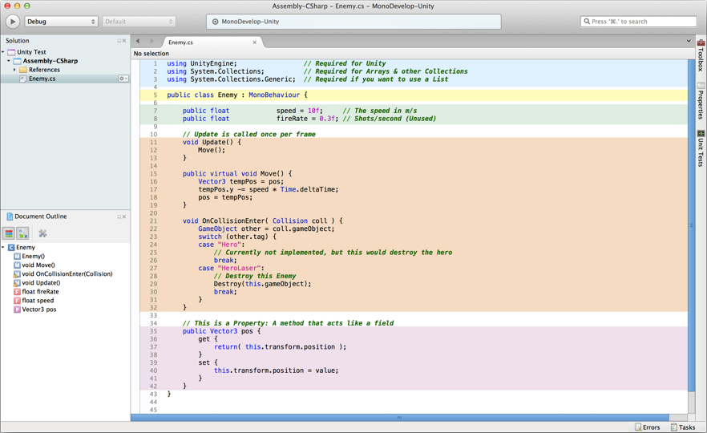
The Anatomy of a Class
Includes
The Class Declaration
Fields
Methods
Properties
p.s. Line numbers are handled automatically by MonoDevelop

Slide 6
The Anatomy of a Class
We'll explore each part of a class named Enemy
  The Enemy class is for a simple top-down space shooter game
  An Enemy instance moves down the screen at a speed of 10
Includes
  Include code libraries in your project
  Enables standard Unity libraries and objects
    e.g., GameObject, MonoBehaviour, Transform, Renderer, etc.
        1 using UnityEngine; // Required for Unity
        2 using System.Collections; // Included by Unity's default
        3 using System.Collections.Generic; // Required to use a List
The Class Declaration
  Declares the name of the class and its superclass
  Enemy is a class that extends its superclass MonoBehaviour
        5 public class Enemy : MonoBehaviour {

Slide 7
The Anatomy of a Class
Fields
  Fields are variables that are part of the class
  Fields marked public are able to be seen by other classes and by other instances of this class
  Fields marked private are only able to be seen by this one instance of a class
    Private fields are secrets
    They are also a safer way to program than always using public fields
    Public fields are used throughout the book so that the field values appear and are editable in the Unity Inspector
        7 public float speed = 10f; // The speed in m/s
        8 public float fireRate = 0.3f; // Shots per second (Unused)
    Declares two public fields for all instances of the Enemy class
    Each instance has its own value for speed and fireRate

Slide 8
The Anatomy of a Class
Methods
  Functions that are part of the class
  Can also be marked public or private
        11 void Update() {
        12 Move();
        13 }
        14
        15 public virtual void Move() { // Move down the screen at speed
        16 Vector3 tempPos = pos;
        17 tempPos.y -= speed * Time.deltaTime; // Makes it Time-Based!
        18 pos = tempPos;
        19 }
  Note that Move is a virtual function
    Virtual functions can be overridden by functions of the same name in a subclass (we'll cover this shortly)

Slide 9
The Anatomy of a Class
Properties
  Properties are methods masquerading as fields
  Properties can only exist within classes
        35 public Vector3 pos {
        36 get {
        37 return( this.transform.position );
        38 }
        39 set {
        40 this.transform.position = value;
        41 }
        42 }
  This property simplifies setting the transform.position of this Enemy

Slide 10
Class Instances as Components
In Unity, all class instances are treated as GameObject Components
  The class instance can be accessed using GetComponent<>()
        Enemy thisEnemy = this.gameObject.GetComponent<Enemy>();
  From there, any public variable can be accessed
        thisEnemy.speed = 20f; // Increase speed of this Enemy to 20
  Many C# scripts can be attached to a single GameObject

Slide 11
Class Inheritance
Most classes inherit from another class
        5 public class Enemy : MonoBehaviour {…}
Enemy inherits from MonoBehaviour
  Enemy is the subclass of MonoBehavior
  MonoBehavior is called the superclass, base class, or parent class of Enemy
  This means that Enemy inherits all of MonoBehaviour's fields and methods
    Example inherited fields:
      gameObject, transform, renderer, etc.
    Example inherited methods:
      GetComponent<>(), Invoke(), StartCoroutine(), etc.
    Inheriting from MonoBehaviour is what makes Enemy able to act like a GameObject component

Slide 12
Class Inheritance
We can create a class that inherits from Enemy!
        1 using UnityEngine;
        2 using System.Collections;
        3
        4 public class EnemyZig : Enemy {
        5 // EnemyZig inherits ALL its behavior from Enemy
        6 }
If this class is attached to a different GameObject, that GameObject will act exactly like an Enemy
  It will also move down the screen at a rate of 10m/second
Move() can be overridden because it is a virtual function
  This means that EnemyZig can have its own version of Move()!

Slide 13
Class Inheritance
EnemyZig.Move() overrides Enemy.Move()
        4 public class EnemyZig : Enemy {
        5 public override void Move () {
        6 Vector3 tempPos = pos;
        7 tempPos.x = Mathf.Sin(Time.time * Mathf.PI*2) * 4;
        8 pos = tempPos; // Uses the pos property of the superclass
        9 base.Move(); // Calls Move() on the superclass
        10 }
        11 }
  Now, when the Update() method in Enemy calls Move(), EnemyZig instances will use EnemyZig.Move() instead
    This moves the EnemyZig instance back and forth horizontally
  On line 9, base.Move() calls the Move() function on EnemyZig's base class, Enemy
    This causes EnemyZig instances to continue to move downward as well

Slide 14
Chapter 25 – Summary
Classes combine data (fields) and functionality (methods)
Classes can inherit from each other
Classes are used in Unity as GameObject Components
Understanding classes is the key to object-oriented programming (OOP)
  Before OOP, games were often a single, very large function
  With OOP, each object in the game is a class, and each class can think for itself
Next Chapter: Object-Oriented Thinking
  The next chapter talks more about the OOP mentality
  Also has a section where you make procedural art!

